Slide 1
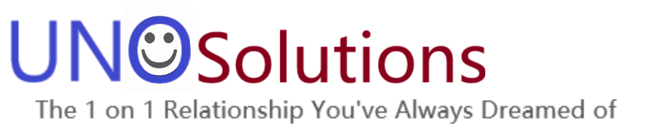
Craft Brewery Presentation
As Prepared By Team Uno Solutions, LLC
Afreen Siddiqui
Anthony Egbuniwe
Bruce Kimbark

Slide 2
Goals for this Presentation
You are interested in opening a craft brewery in the United States
We have been hired to identify:
The best locations to place a new brewery
Strong market opportunity
Consider existing competition against regional economic strength
Based upon current craft brewery landscape
The best products to offer
Most popular products on the market today
Opportunity to choose popular choices as a baseline while offering a chance to produce some uncommon options to create a market niche

Slide 3
Overview
This presentation we will touch upon the following topics:
A general overview of the craft beer industry
A brief discussion of our data gathering and analysis
Discussion of best opportunities for a new brewery
Discussion of the beer options available
An analysis of the craft beer data
Conclusion with our recommendations

Slide 4
Craft Beer Industry

Slide 5
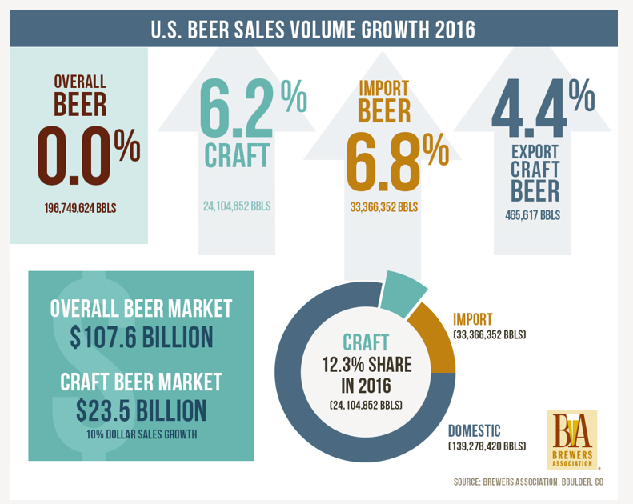
The Craft Beer Industry is Gaining Larger Market Share
While overall beer production is stagnant, craft beer grew 2016
12.3% of volume sold was craft. An increase of 6.2%
21.8% of the dollar sales was craft. An increase of 10%.
The average craft beer six pack sells for $25-$36. Far higher than the typical price for a national brewer’s products.

Slide 6
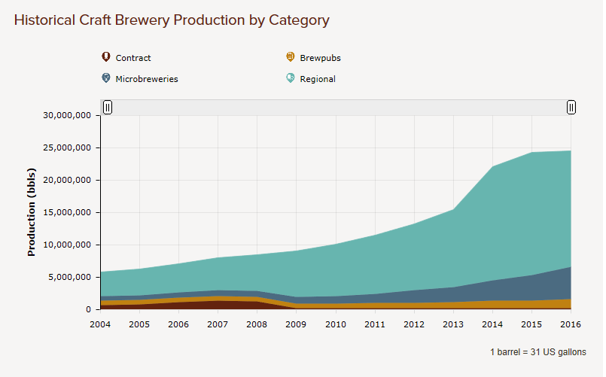
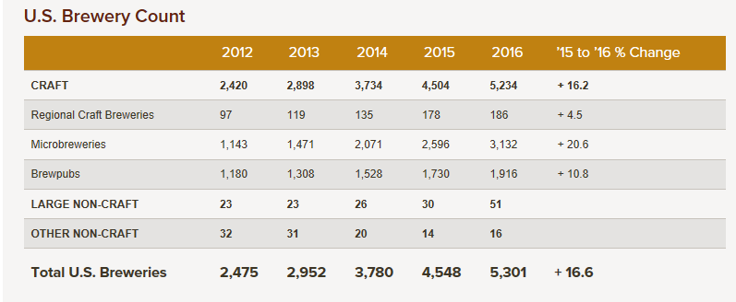
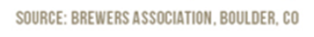
The Craft Beer Industry is Still Growing
After explosive growth the past few years, growth has slowed.
But there is still opportunity for a smart brewer.
Regional breweries make up approximately 71% of the craft beer industry
Microbreweries are gaining traction
Regional Brewery: A brewery that produces over 15,000 barrels and produces beer in a traditional or non-mechanized way.
Microbrewery: produces less than 15,000 barrels and sells over 75% of its beer off-site
A regional brewery is the goal but will need to start as a microbrewery

Slide 7
Data Gathering & Analysis

Slide 8
Data Used
We were provided two data sets to begin
A list of successful craft breweries across the nation
By Brewery Name, City, and State
A list of the bottled products these breweries offer
With the ABV, IBU, Craft Style, and Bottled Ounces
To assist with this we supplemented additional information from varying sources
States GDP per Capita - Spreadsheet that list the GDP per capita of each of the states over the past 20 years.
Barrels Per Year By State - Lists the total craft beer output for each state.
Economic Impact - The economic impact the craft beer industry has listed by state in terms of labor, sales, and designated by number of adults over 21
Total Populations By State - A total of 2016 populations broken down by over and under 18 years of age.
Note: Each of these files source information can be found in our GitHub repository

Slide 9
Our Analysis
We have cleaned, merged, and analyzed the data
Using R and a little Excel
We have placed this all onto GitHub for you to view
We have answered seven basic questions regarding the information
This will be key to assisting you with your request
The data will lead us to the answers

Slide 10
Best Opportunities for a New Craft Brewery

Slide 11
What we are looking for
We want to be in the Microbrewery and Regional Brewery Space
Still growing, with significant opportunity
Limited competition or at minimum space to operate
We will combine the Brewery, Barrel Production, and Alcoholic Production data
We want to be in a large population center
Maximize our customer base – We will use our Adult Population data
We want to be in an area with disposable income
We will use our State GDP data
By doing so we believe we can find the best chances for long term success

Slide 12
Question 1: Number of Breweries Per State
State | Number of Breweries from Data | State | Number of Breweries from Data | State | Number of Breweries from Data
Alabama | 3 | Kentucky | 4 | North Dakota | 1
Alaska | 7 | Louisiana | 5 | Ohio | 15
Arizona | 11 | Maine | 9 | Oklahoma | 6
Arkansas | 2 | Maryland | 7 | Oregon | 29
California | 39 | Massachusetts | 23 | Pennsylvania | 25
Colorado | 47 | Michigan | 32 | Rhode Island | 5
Connecticut | 8 | Minnesota | 12 | South Carolina | 4
Delaware | 2 | Mississippi | 2 | South Dakota | 1
District of Columbia | 1 | Missouri | 9 | Tennessee | 3
Florida | 15 | Montana | 9 | Texas | 28
Georgia | 7 | Nebraska | 5 | Utah | 4
Hawaii | 4 | Nevada | 2 | Vermont | 10
Idaho | 5 | New Hampshire | 3 | Virginia | 16
Illinois | 18 | New Jersey | 3 | Washington | 23
Indiana | 22 | New Mexico | 4 | West Virginia | 1
Iowa | 5 | New York | 16 | Wisconsin | 20
Kansas | 3 | North Carolina | 19 | Wyoming | 4
R Code: table(breweries$State2)
These are the number of breweries in each state from the given data

Slide 13
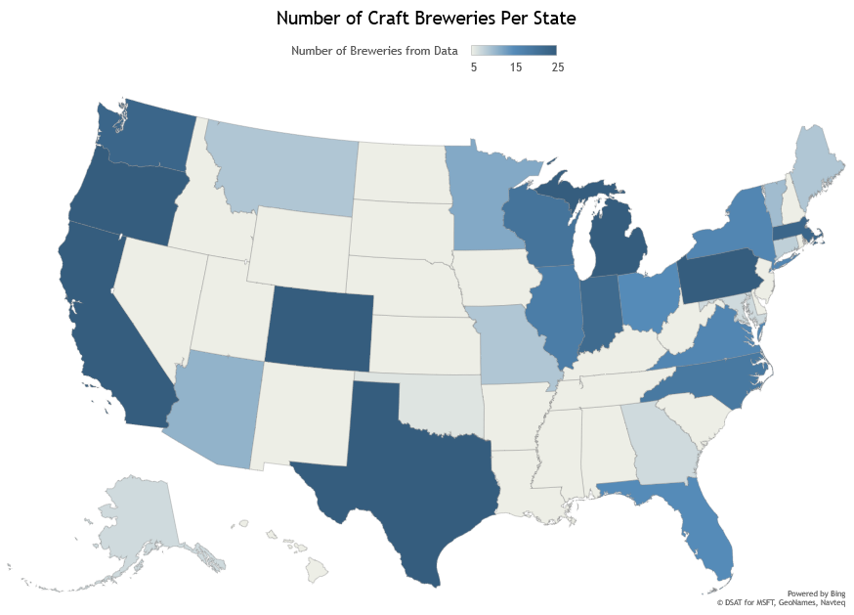

Craft Breweries by State in Visual Form
The color code to this chart is broken down in groups of 5 and under, 15, and 25 and over.
There are many states with limited information. The scale is very small.
We analyzed this in a different way

Slide 14
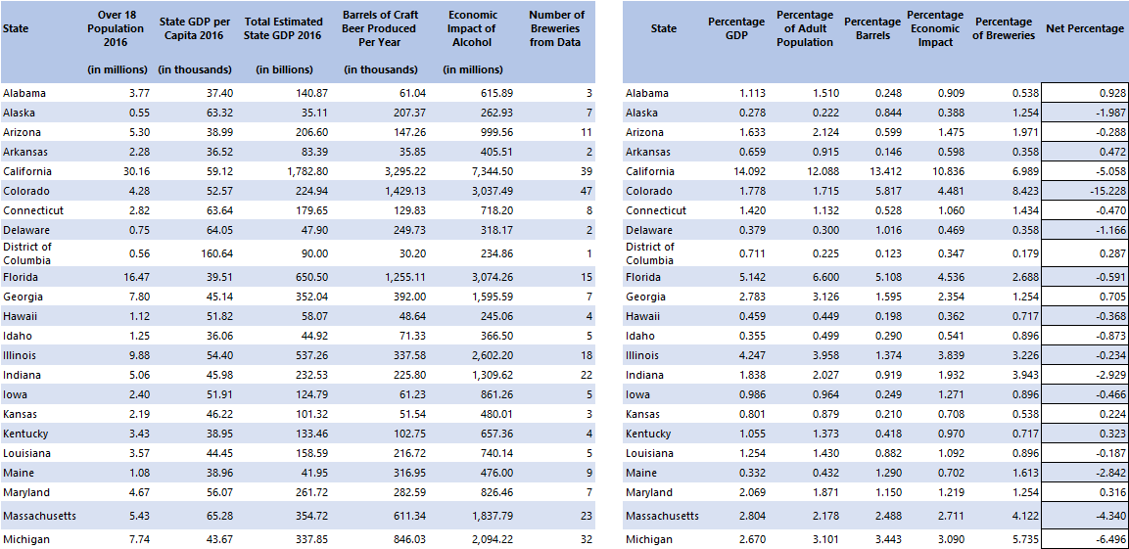
Brewery Analysis
First, we merged all the information into one object
Then removed all the excess information leaving us with only the key fields
Below is the first 12 rows of the data
Then we took each states percentage of the total country in each of these categories. To read this, California’s 2016 GDP Percentage is 14.092% of the US total.
We then added the GDP and Adult Population Rankings and subtracted the remaining values to get a Net Percentage value.
We feel this gives a fair ranking of economic strength for each state less its current craft brewing production.

Slide 15
Bar Chart of Net Percentage
This chart shows a clear visual of the states with the best chances for craft success.
The green states are those with the best economic and adult populations with comparatively low craft brew output
The red are states where craft brewing exceeds their economic and adult capacity in relation to all states.

Slide 16

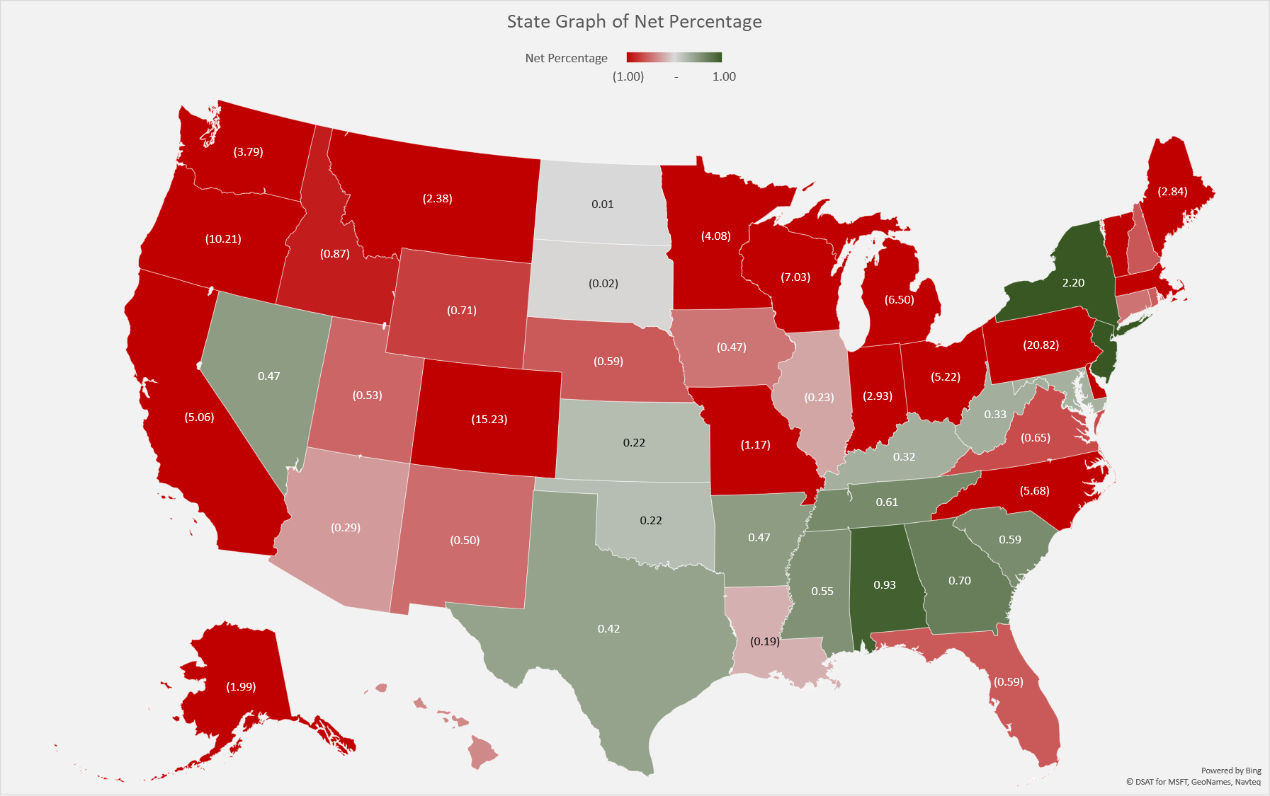

Graph of Net Percentage and Conclusion
This chart shows a clear visual of the states with the best chances for craft success.
The green states are those with the best economic and adult populations with comparatively low craft brew output
The red are states where craft brewing exceeds their economic and adult capacity in relation to all states.
Conclusion: The best states we suggest to target are:
Alabama with a strategy to target the surrounding states

Slide 17
Product Line Suggestions

Slide 18
2. Merge beer data with the breweries data. Print the first 6 observations and the last six observations to check the merged file.
beersnbrew <- merge(beers, breweries, by.x=c("Brewery_id"), by.y = c("Brew_ID"), all=FALSE)

Slide 19
3. Report the number of NA's in each column.

Slide 20
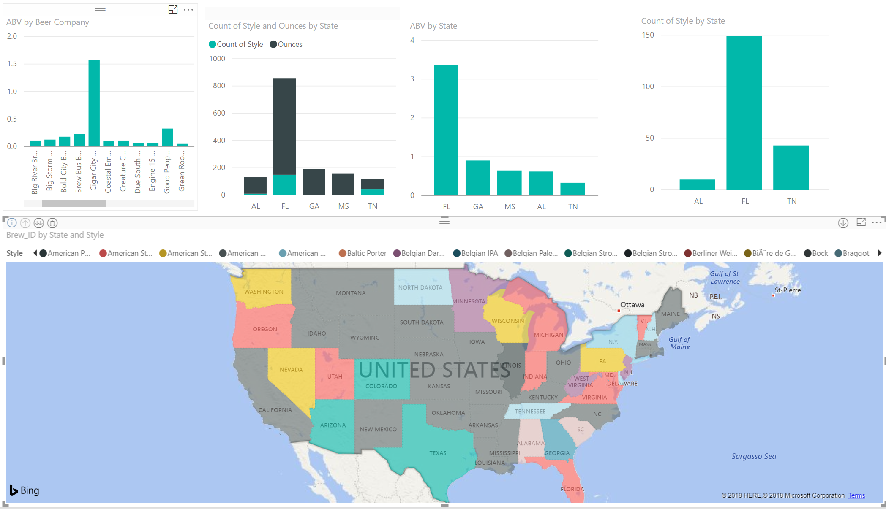
Competitive Analysis of Surrounding Area
We did a competitive analysis of stationing a Brewery within Alabama with a strategy to target the surrounding states.
This chart shows a clear visual of the states with the top beer style and ABV by Brewery.
Through our research we found the top three beers to sell would be.
American Brown Ale
American IPA
American Amber\ Red Ale
Top three states to target sells.
Alabama
Tenseness
Mississippi

Slide 21
Further Analysis of the Data Provided

Slide 22
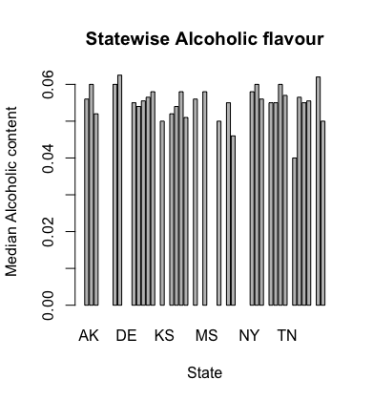
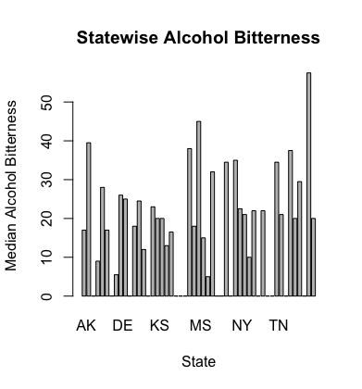
4. Compute the median alcohol content and international bitterness unit for each state. Plot a bar chart to compare.

Slide 23
5. Which state has the maximum alcoholic (ABV) beer? Which state has the most bitter (IBU) beer?
maxABV <- beersnbrew[which.max(beersnbrew$ABV), ]
"State with maximum alcoholic (ABV) beer ” = “CO”
maxIBU <- beersnbrew[which.max(beersnbrew$IBU), ]
"State with the most bitter (IBU) beer ” = “OR”

Slide 24
6. Summary statistics for the ABV variable.

Slide 25
7. Is there an apparent relationship between the bitterness of the beer and its alcoholic content? Draw a scatter plot.
ggplot(beersnbrew, aes(x=IBU, y=ABV)) +geom_point(shape=18, color="blue")+geom_smooth(method=lm, se=FALSE, linetype="dashed",color="darkred")
The figure shows a fuzzy linear correlation with the
Coefficient correlation value as 0.4.
That proofs that there is a slight positive correlation
between the alcoholic content and bitterness.

Slide 26
Conclusion
Colorado has the highest number of breweries among all states followed by California, Michigan.
Portland has the highest number of breweries among all major US cities followed by Chicago, Seattle.
IPA is the most popular beer style in US.
For the best current opportunity, we suggest:
To open your craft brewery in Alabama
To craft an American Brown Ale, American IPA and American Amber\ Red Ale to have a competitive base that mirrors the demand across the country
To experiment with crafting lesser produced beers to create demand for something new and attract new customers to try products not in the surrounding market.

